Slide 1
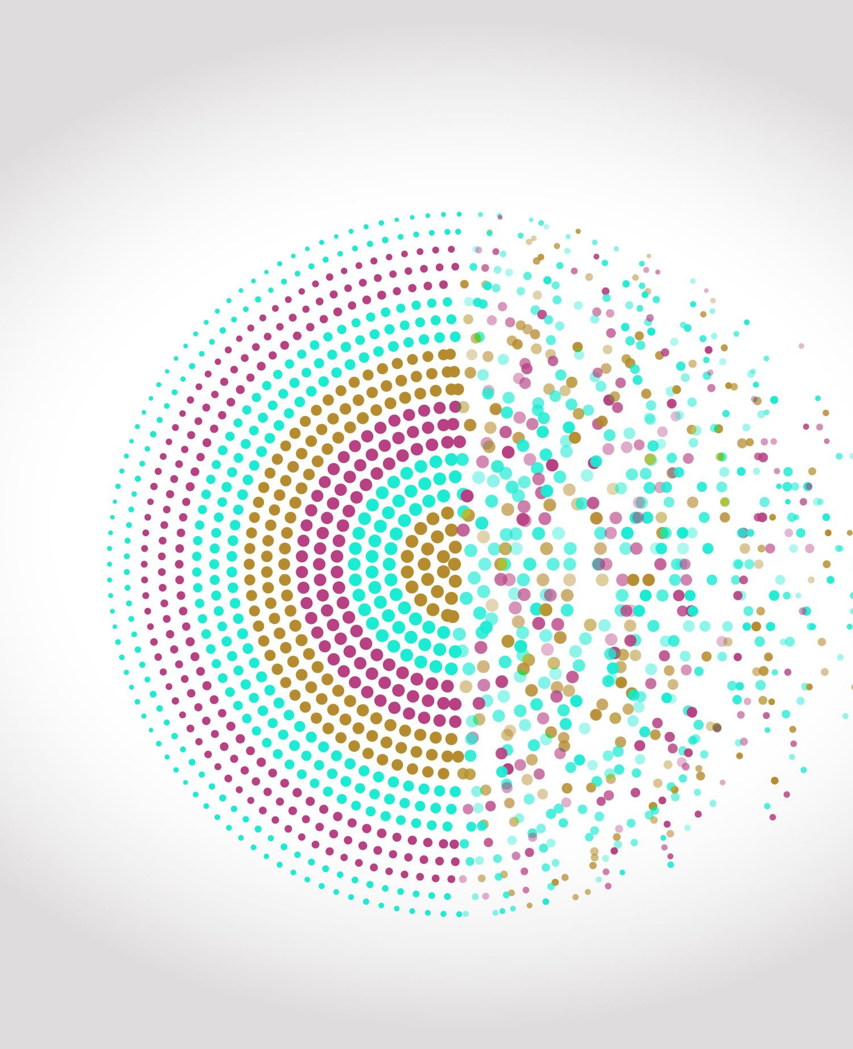
REVOLUTIONARY AI UNVEILED: UNMASKING GENDER PREDICTION AND FACIAL TRANSFORMATION WITH DEEP LEARNING MASTERY
Group 6: Cameran Frank, Ishu Kalra, Siche Chen, Zijian Wang, Yaasir Ahmed

Slide 2
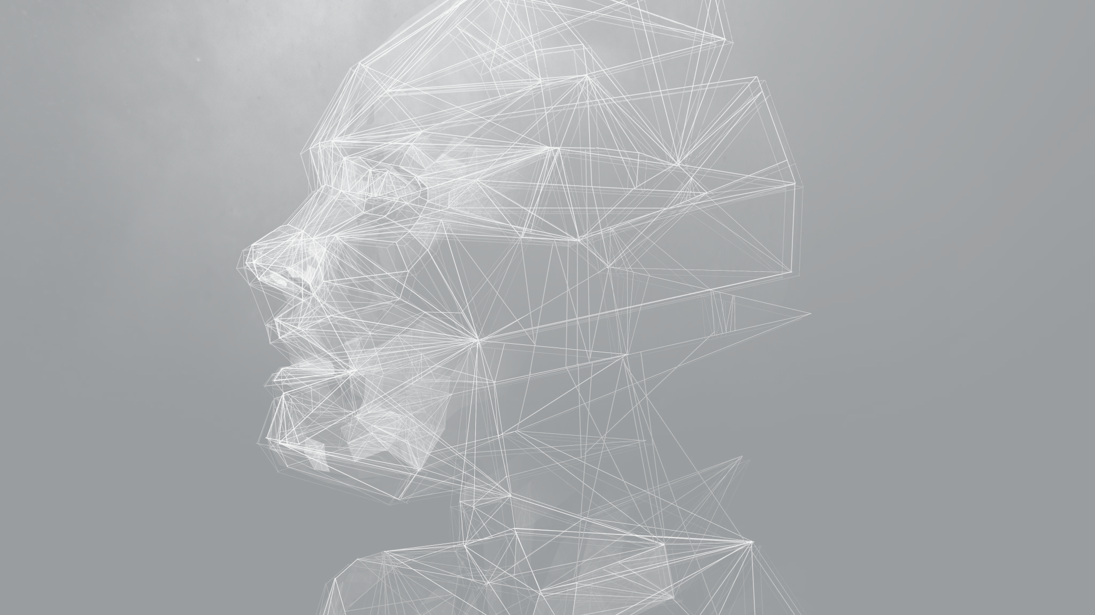
ABSTRACT
Background Introduction
Image processing poses significant challenges, particularly in the domains of gender prediction and facial transformation. These tasks hold immense potential for various applications and require sophisticated techniques to achieve accurate and visually appealing results.
Approach
Our project aims to revolutionize image processing through deep learning. By employing convolutional neural networks, we will enhance gender prediction accuracy and explore transformative generative images. Join us as we push the boundaries of image processing, unleashing the true potential of gender prediction and facial transformation.

Slide 3
ABSTRACT
Dataset Introduction
The CelebA dataset is a large-scale collection of over 200,000 celebrity images, widely used in computer vision and facial analysis research. It provides annotations for various facial attributes, including gender, age, presence of glasses, and facial expression. The dataset serves as a benchmark for training and evaluating models in tasks such as face recognition, attribute prediction, and facial analysis. With its rich annotations and diverse image set, CelebA has played a significant role in advancing the field of facial analysis and enabling the development of state-of-the-art techniques.

Slide 4
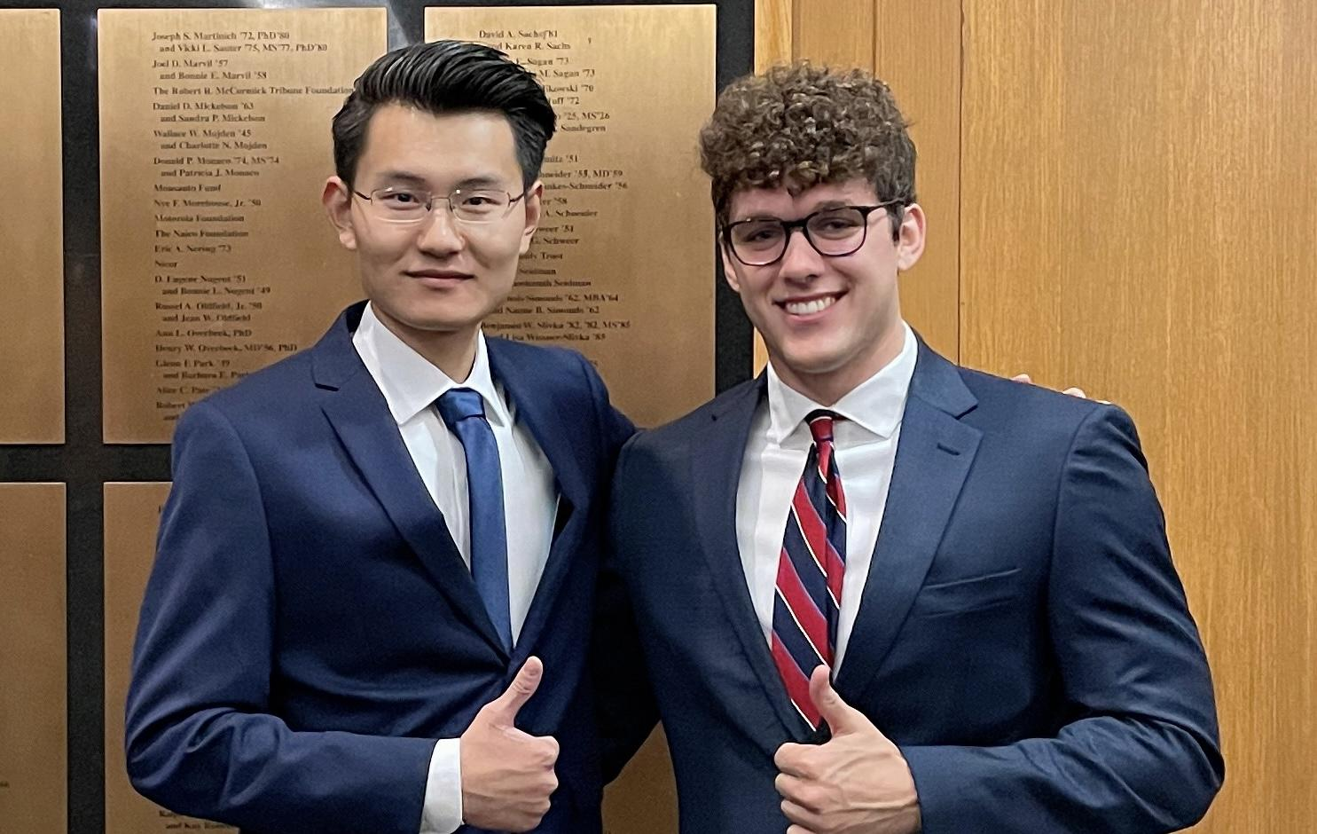

ABSTRACT
Result in mind:

Slide 5
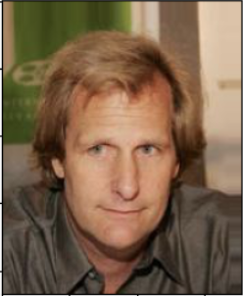

ABSTRACT
Result achieved: Jeff Daniels, American Actor from Dumb and Dumber

Slide 6

Exploratory Data Analysis (EDA)

Slide 7
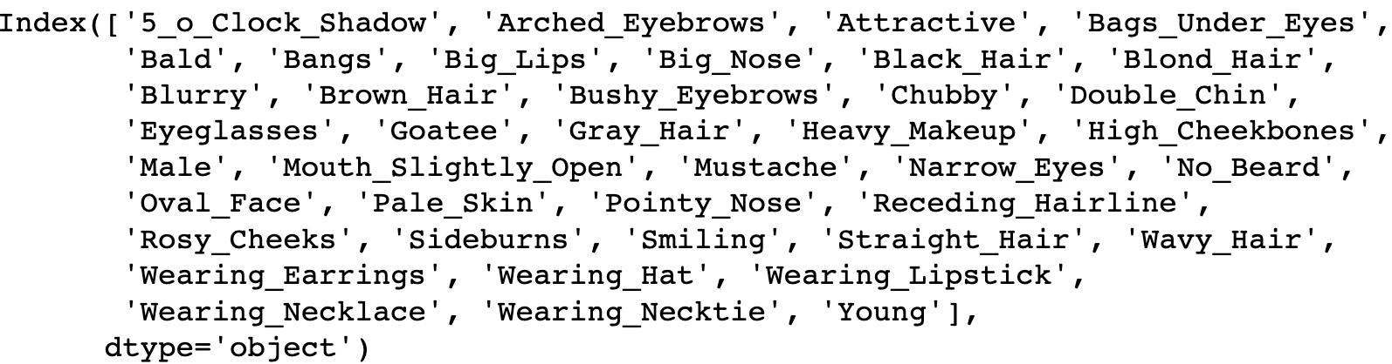
EXPLORATORY DATA ANALYSIS
Tables: Attributes table, Partitioning table, Bounding box table, and Landmarks table.
Data Summary - Attributes Table
Record counts: 202,599
Missing value: None
Features: 40

Slide 8
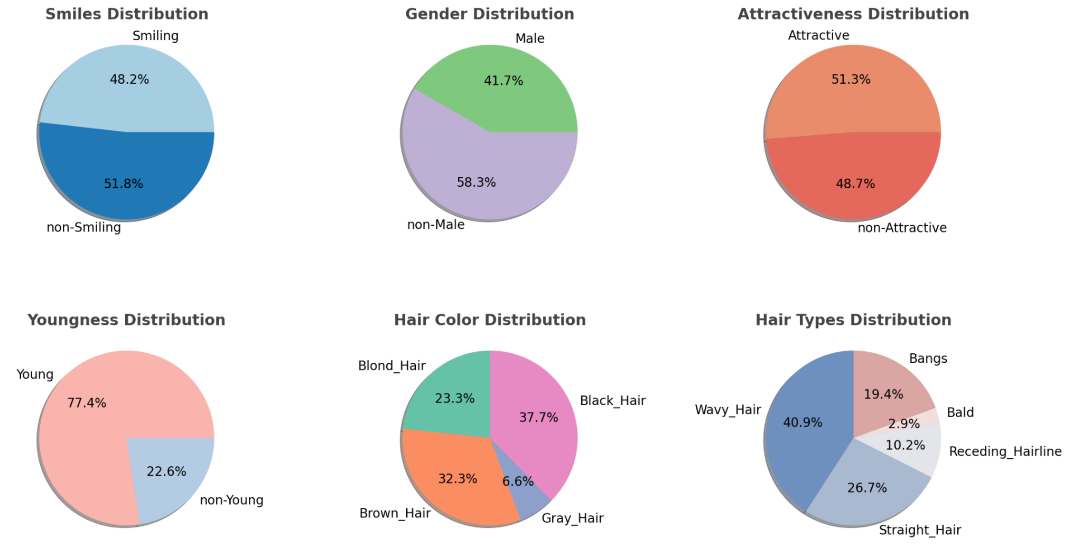
EXPLORATORY DATA ANALYSIS
Attribute Distribution

Slide 9
EXPLORATORY DATA ANALYSIS
Attribute Distribution

Slide 10
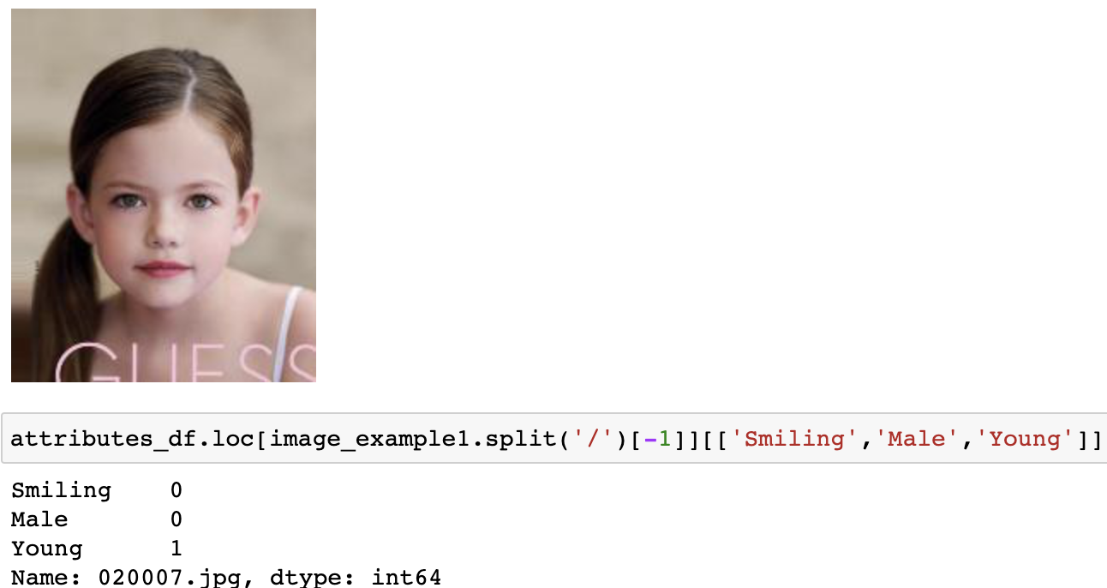
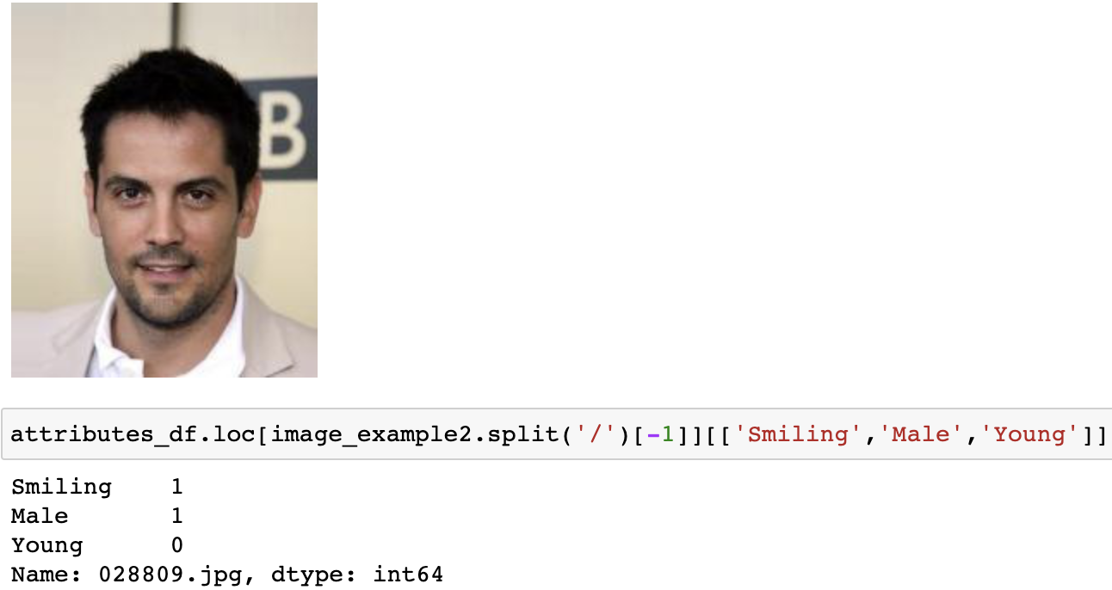
EXPLORATORY DATA ANALYSIS
Image Data
Sample Images - Test for three features: “smiling”, “male”, “young”
Sample 1
Sample 2

Slide 11

MODEL TRAINING AND EVALUATIONS

Slide 12
COGNITIVE PROBLEMS:
Gender Classification
Embark on an extraordinary journey through the realm of gender prediction as we harness the power of advanced models to unravel the enigmatic nature of facial features. Witness the convergence of cutting-edge technology and deep insights, as we reshape the landscape of image processing. Prepare to be captivated as we unveil the secrets hidden within each pixel, forever changing the way we perceive gender.
Generative Images
Step into a realm where pixels merge with imagination, creating captivating Generative Images. Beyond traditional art, these compositions blend algorithms and human ingenuity, crafting mesmerizing visions that defy boundaries. Guided by lines of code, each pixel becomes a brushstroke of innovation, unveiling a universe where art is woven from the fabric of possibility. Welcome to a symphony of creativity, where pixels dance with mathematical equations, and visual poetry unfolds before your eyes.

Slide 13

GENDER CLASSIFICATION

Slide 14
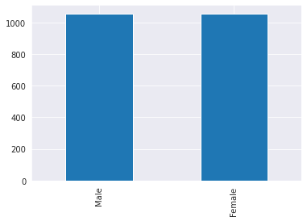
GENDER CLASSIFICATION
There is equal representation of Males and Females
We will use transfer learning, specifically, VGG19 model’s base layers to train
We flatten it out and add 5 more dense layers to predict
We also added early stopping and learning rate reduction too

Slide 15
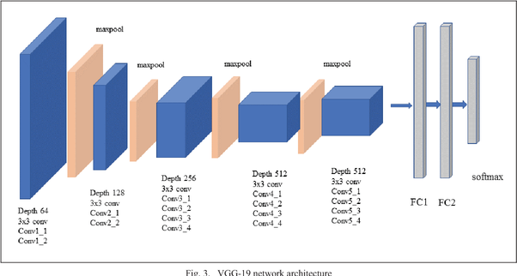
GENDER CLASSIFICATION
The convolutional layers are composed of small 3x3 filters with a stride of 1 and a padding of 1, followed by a max pooling layer with a 2x2 filter and a stride of 2.

Slide 16
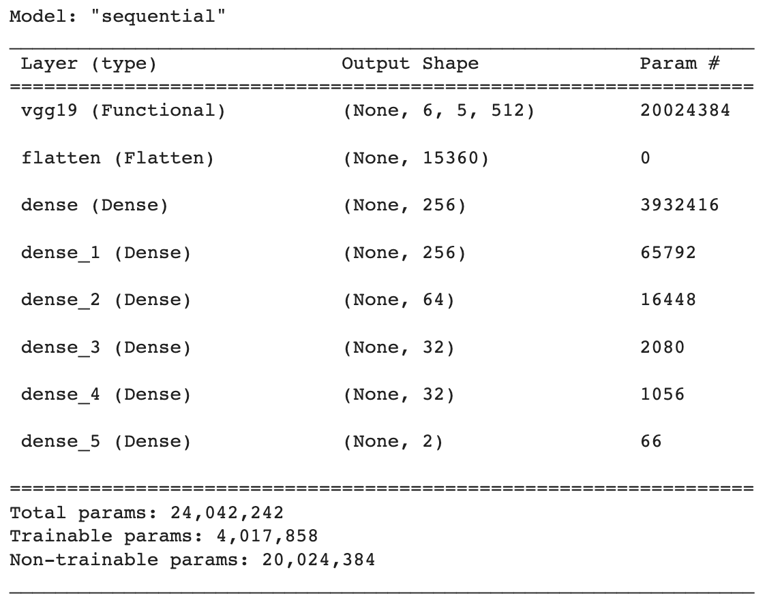
GENDER CLASSIFICATION
In total, we have ~4M params to train
The training, on a MBP M2 chip with early stopping and learning rate reduction was quite fast and took ~2 minute
The non-trainable params are due To freezing the layers of VGG19

Slide 17
GENDER CLASSIFICATION
Model Maintenance and Parameter Update Process
Process | Description
Monitoring | Track model performance metrics (e.g., especially confusion matrix)
Retraining and Parameter Updates | Do online training (on layman) and periodically retrain, adjusting the parameters to remove any bias.
Data Drift | It is a part of monitoring process to ensure that the training and test data matches and re-train if need be.
Model Saving and Loading | Save and load the trained model weights and architecture for reuse. It will save time and computing power

Slide 18
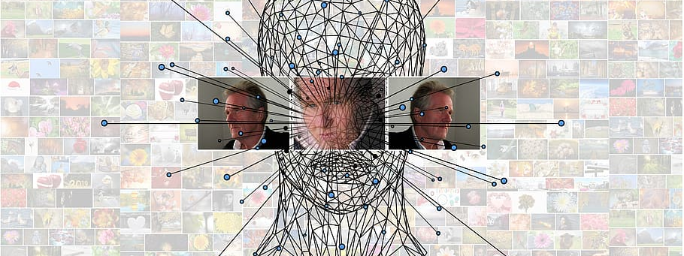
GENERATIVE IMAGES:
Variational Autoencoders (VAEs)

Slide 19
GENERATIVE IMAGES: VAE
Component | Function | Key Details
Encoder | Transforms input data into a latent representation | Takes image of defined height, width, and 3 color channels as input Processes image through convolutional blocks with increasing filter size Flattens the processed image and generates a latent vector If is_variational is True, z is sampled from a Gaussian distribution defined by z_mean and z_log_sigma
Decoder | Recreates original input from the latent representation | Takes the latent vector z as input Expands z through a dense layer to match the encoder's bottleneck dimensions Processes expanded z through deconvolutional blocks with decreasing filter size Uses a convolution operation and 'tanh' activation to generate output image
Full VAE | Combines the encoder and decoder | Takes an image as input, encodes it with the encoder, and then decodes it with the decoder If is_variational is True, uses a custom loss function vae_loss that combines MSE for reconstruction and KL divergence for regularization

Slide 20
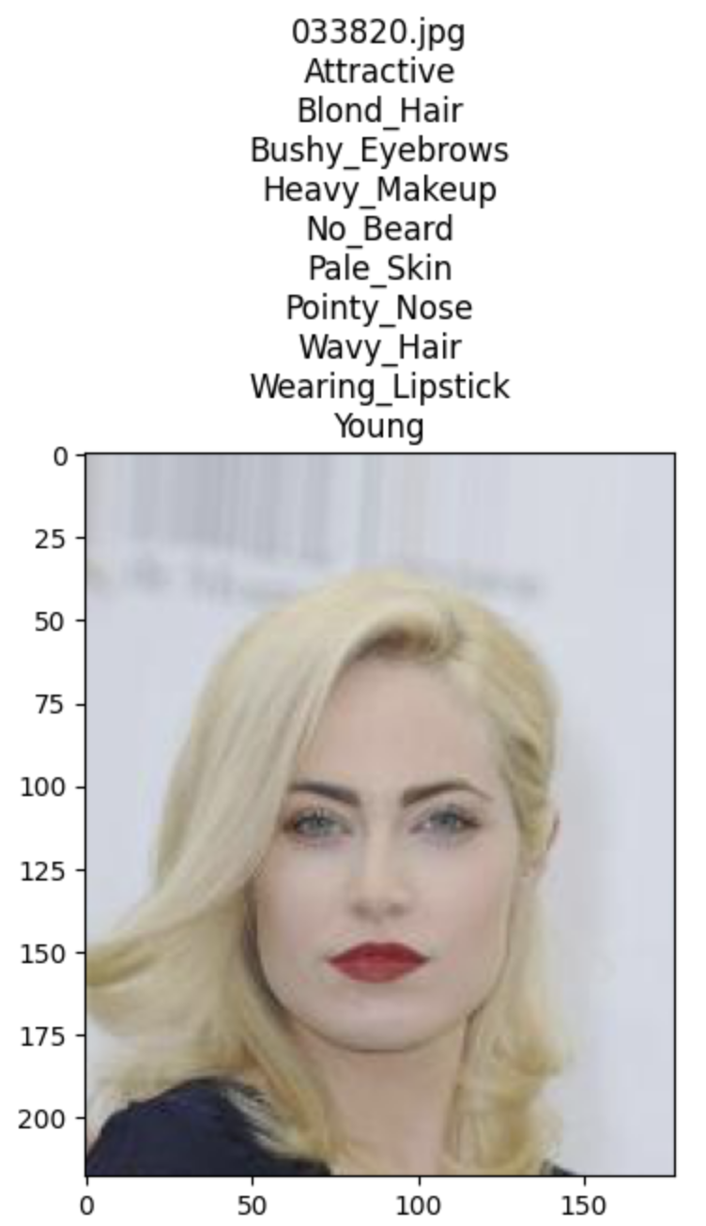
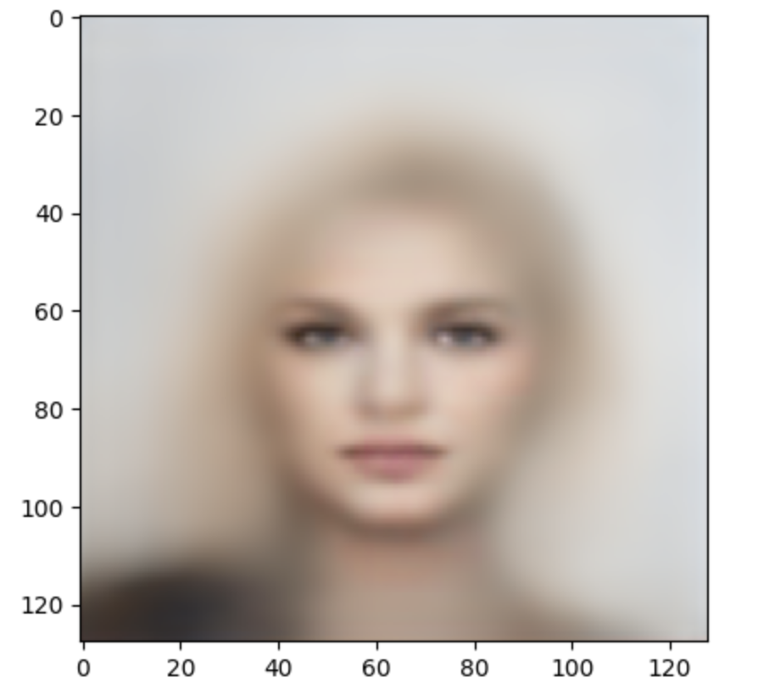
GENERATIVE IMAGES: VAE
Charlotte Sullivan
Execute encoder and decoder
Encoder and Decoder in layman's terms “softens” the attributes of original picture.
By introducing noise.
Creating latent space
Doing so allows for future manipulation, makes the picture more malleable.

Slide 21
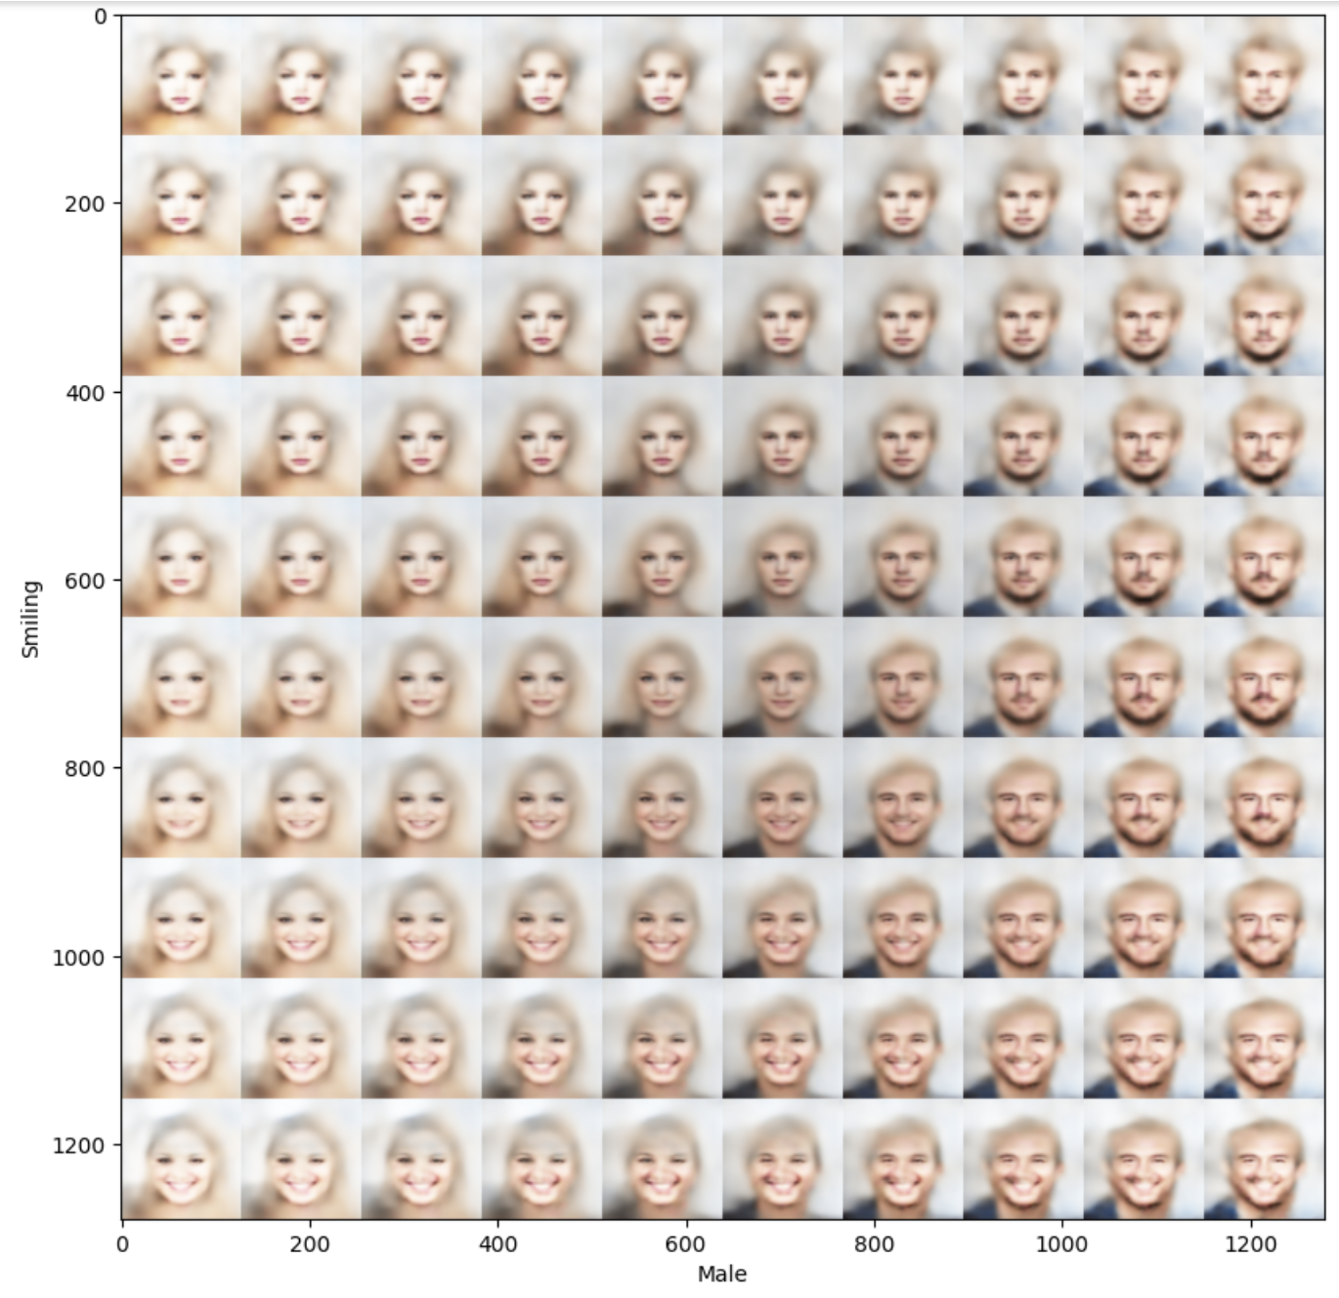
GENERATIVE IMAGES: VAE
Takes the decoded image from the previous slide
Focus is on two attributes: 'Male' and 'Smiling'.
Construct a base latent vector using existing data and sample image metadata.
By modifying the 'Male' and 'Smiling' attributes in the base vector, a grid of images displaying a smooth transformation from a non-smiling female to a smiling male is generated.

Slide 22
GENERATIVE IMAGES: VAE
Model Maintenance and Parameter Update Process
Process | Description
Monitoring | Track model performance metrics (e.g., reconstruction loss)
Bug Fixes | Address reported bugs or issues in the code or model
Retraining | Periodically retrain the VAE model using updated data to improve performance
Parameter Updates | Experiment with different hyperparameters or model configurations to optimize performance
Model Saving and Loading | Save and load the trained model weights and architecture for reuse

Slide 23
GENERATIVE IMAGES: VAE
Model Deployment Mechanism/Architecture
Component | Description
Client Application | Interface for user interaction with the generative image model
Backend Server | Hosts the trained VAE model, processes requests, performs encoding and decoding of images
Data Storage | Stores training data, generated images, and metadata
Model Files | VAE model files (encoder, decoder, and VAE) saved as JSON and weights saved in separate files
Later Host on
Streamlit

Slide 24

Conclusions

Slide 25
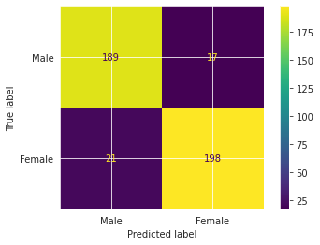
FINDINGS DISCUSSION
GENDER CLASSIFICATION
Pros #1: In general, our model performed quite well as shown
Pros #2: It didn’t perform worse for either male or female and is truly gender equal
Cons #1: The model is trained on “celebrity” dataset and therefore can fail on a layman
Cons #2: The model is biased to consider 2 genders and training data needs to be augmented to have more representation from non-binary people

Slide 26
FINDINGS DISCUSSION
Variational Autoencoders (VAEs)
Pros:
Generative Modeling:
VAEs are generative models used for data synthesis and image generation.
Latent Space Representation:
VAEs learn interpretable features in latent space.
Continuous Latent Space:
VAE's latent space enables smooth interpolation.
Cons:
Blurriness and Lack of Sharpness:
VAE-generated samples may appear blurry.
Difficulty Capturing Fine Details:
VAEs struggle with fine details.
Model Collapse:
Where the model fails to capture the full diversity of the training data and instead generates samples that cluster around a few dominant modes.

Slide 27
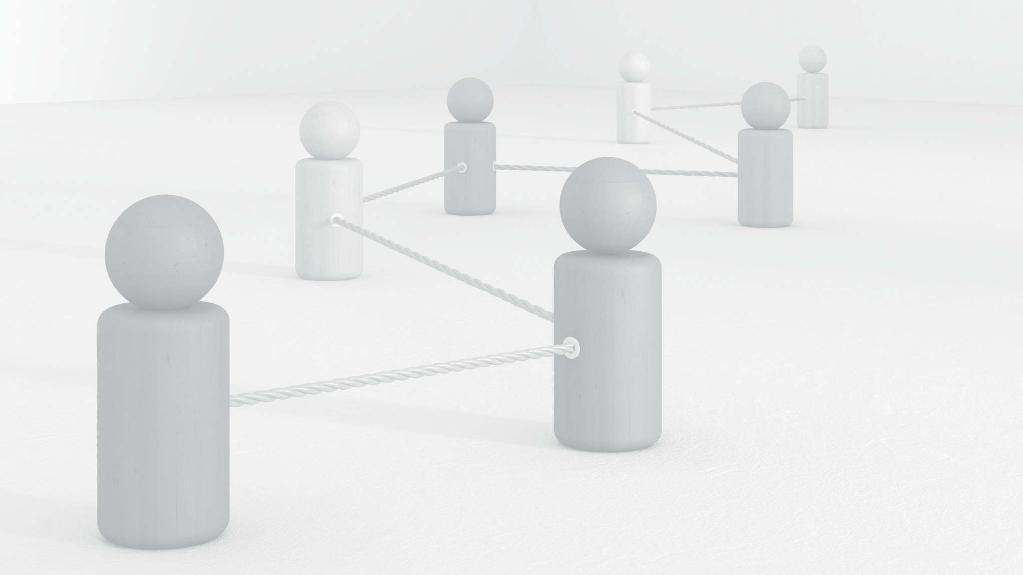
Conclusion
Task | Achievements
Gender Prediction | Significant advancements, accurate classification with high precision
Generative Images | Extracted intricate facial features, VAE-based generative image manipulation, diverse and realistic image synthesis
Future Work | Integration of gender prediction with VAE-based image manipulation, redefining deep learning limits, potential advancements in image processing and creative exploration Host so that would could input a picture and able to manipulate the pictures attributes

Slide 28
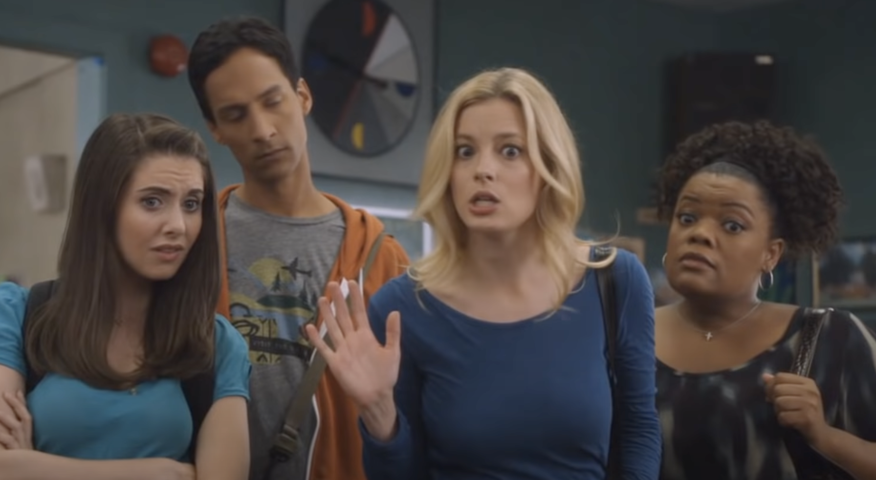

Future steps
From TV show Community Live run on a video and not just images
Video URL: https://www.youtube.com/watch?v=OFERQW27EhU

Slide 29
REFERENCE
Data source (CelebA Dataset)
http://mmlab.ie.cuhk.edu.hk/projects/CelebA.html

Slide 30
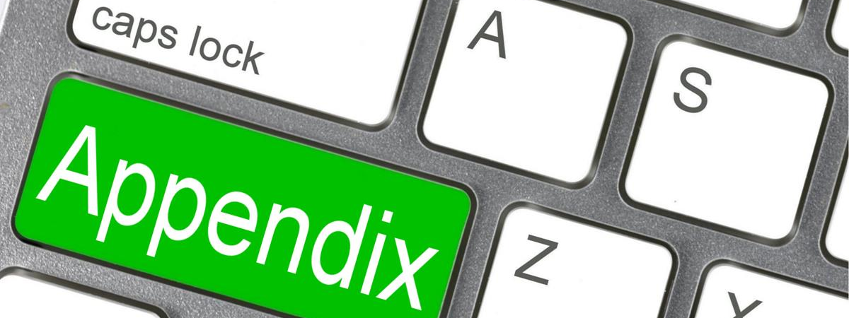
Appendix

Slide 31
GENERATIVE IMAGES: VAE
Summary
Variational Autoencoders (VAEs) are a specific type of deep learning model used in the realm of artificial intelligence. These models, specifically designed for dealing with images, leverage the principles of neural networks, probability, and statistics to generate new data similar to the input data they've been trained on.
Key Points:
Deep Learning: The use of encoder and decoder networks in VAEs is a classic architecture seen in deep learning. These networks learn to map the data to a lower-dimensional latent space and back, respectively, through multiple layers of non-linear transformations.
Artificial Intelligence: VAEs are a part of the generative models category in AI, which aim to understand and generate data that resembles the input data. They can be used in a variety of applications, such as image generation, anomaly detection, denoising, and more.
Image Processing: In the context of images, VAEs can learn to generate new images that are similar to those in the training set. This has wide-ranging applications, from art and design to healthcare, where it can be used to augment data sets or generate synthetic data for training other models.
In summary, VAEs leverage the power of deep learning to offer a robust and versatile approach in the field of AI, particularly in tasks that involve understanding and manipulating image data.

